Slide 1
SC1015 Mini project : Thinking of getting a new dog?
FCCA Group 05: Chng Jia De, Trix Chong, Tanya Kwek

Slide 2
Problems and Goals
Increase in pet abandonment cases in Singapore
Due to lack of compatibility between dogs and their ex- owners
20%
What is the chance a certain breed of dog will be suitable for novice pet owners?

Slide 3
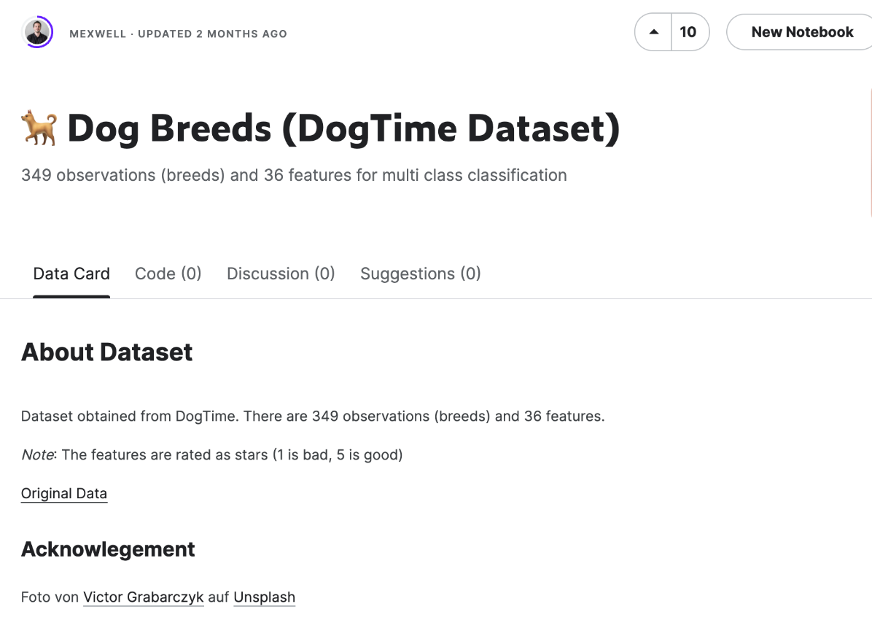
Our Dataset
Size of dataset: 349
Number of variables: 37

Slide 4
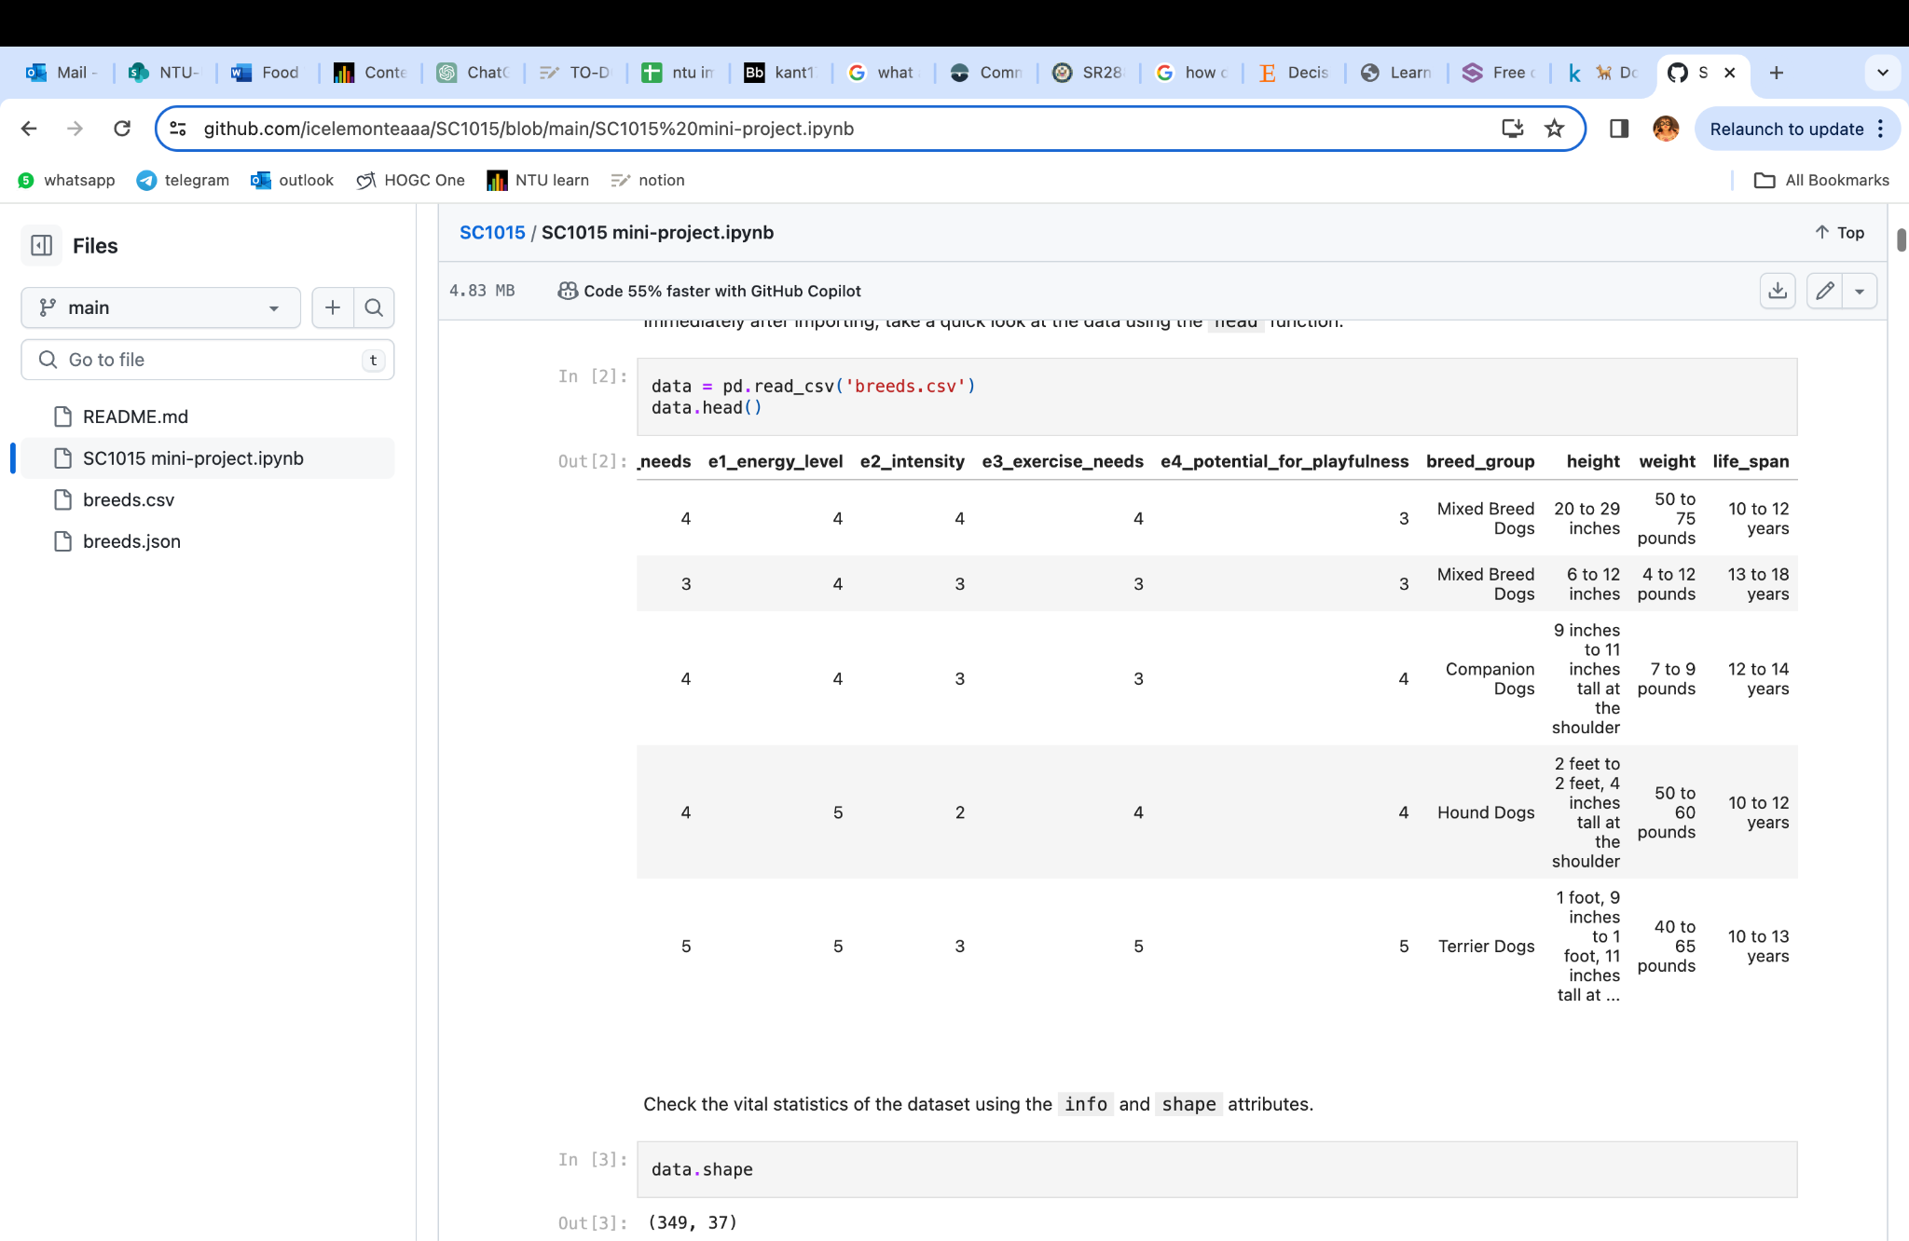
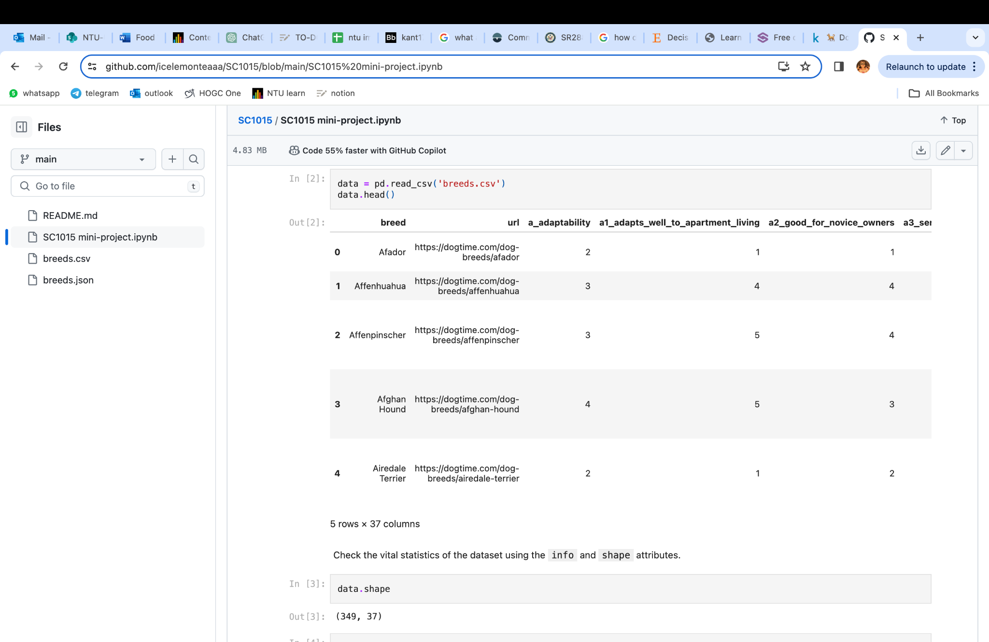

Our Dataset
Data type: int64
Data type: object

Slide 5
Data Cleaning & Exploratory Data Analysis
columns_to_drop = ['a_adaptability', 'b_all_around_friendliness', 'c_health_grooming', 'd_trainability', 'e_exercise_needs']
datadf = data.drop(columns=columns_to_drop)
Group A (“a_adapatability”)
A1_adapts_well_to_apartment_living
A3_sensitivity_level
A4_tolerates_being_alone
A5_tolerates_cold_weather
a6_tolerates_hot_weather

Slide 6
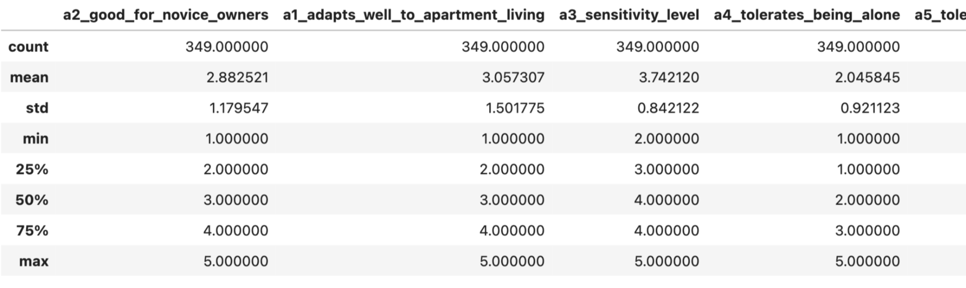
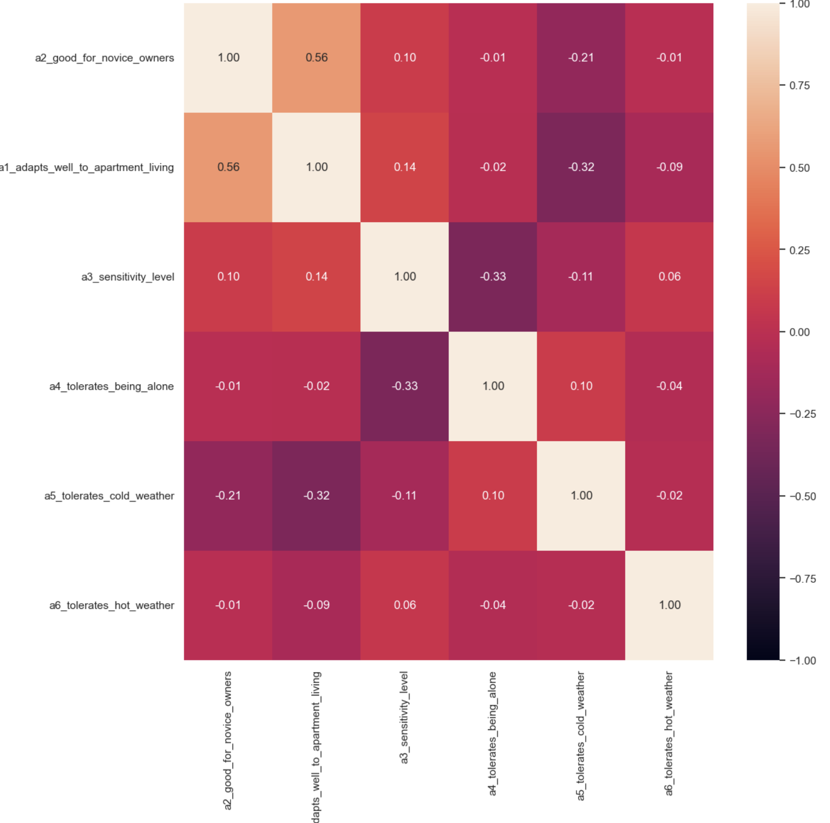
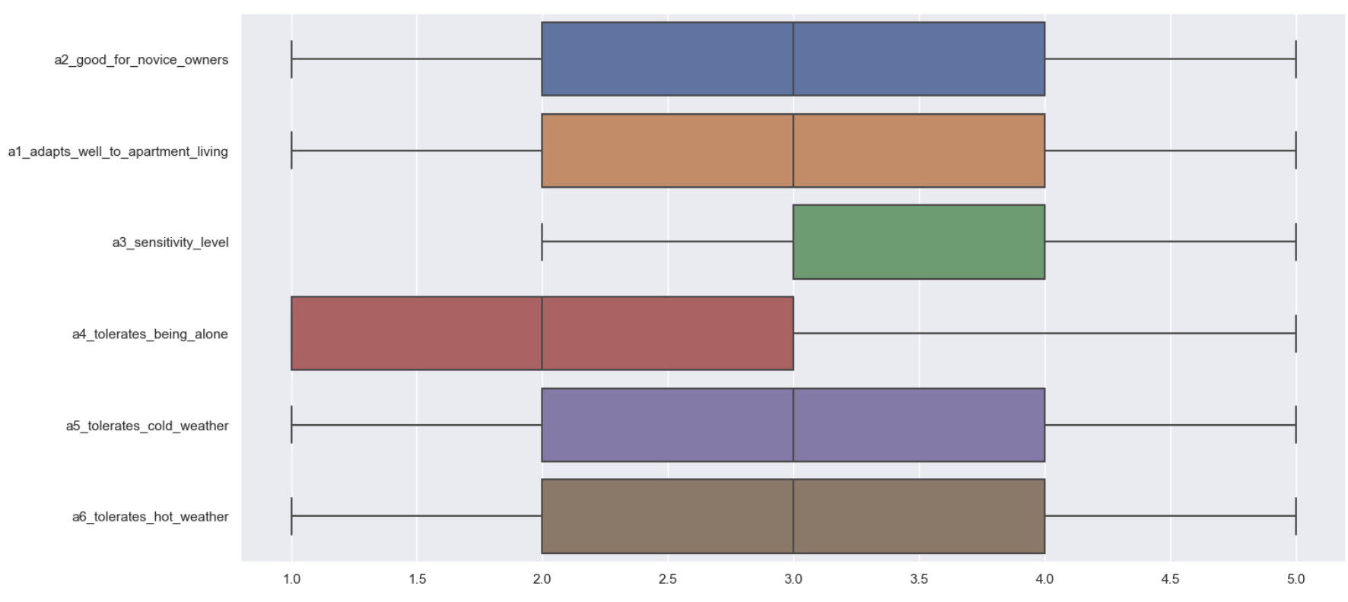
Data Cleaning & Exploratory Data Analysis

Slide 7
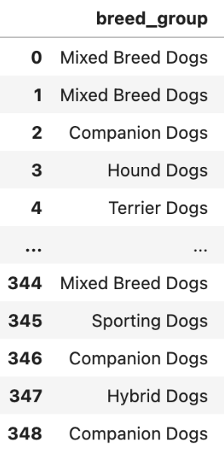
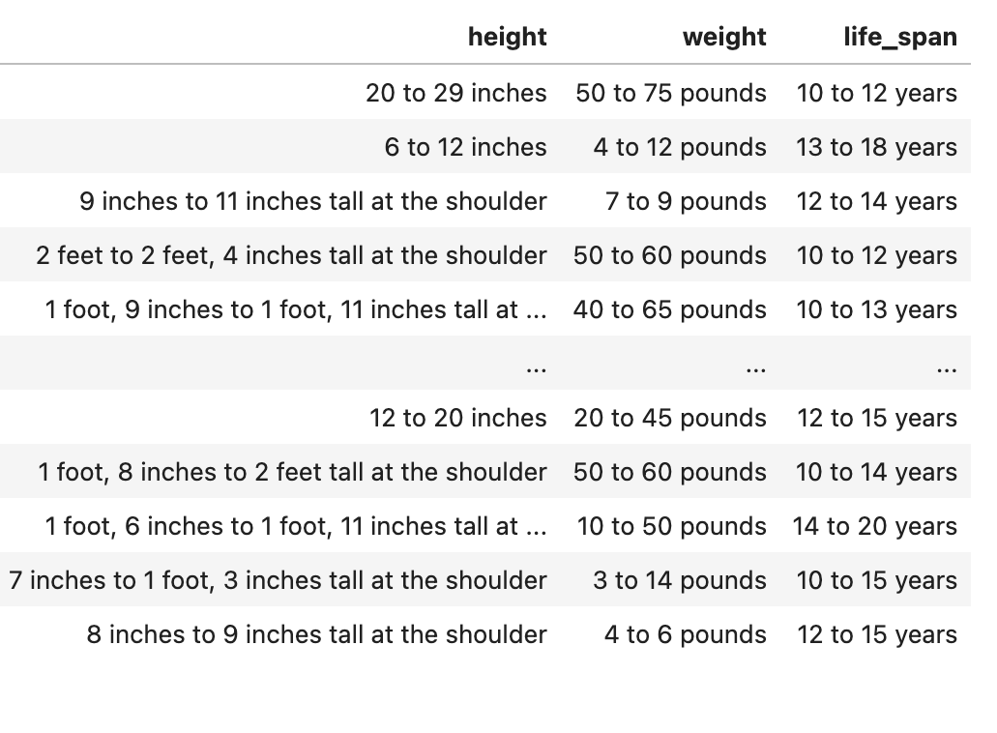
Data Cleaning & Exploratory Data Analysis
Categorical
Numerical

Slide 8
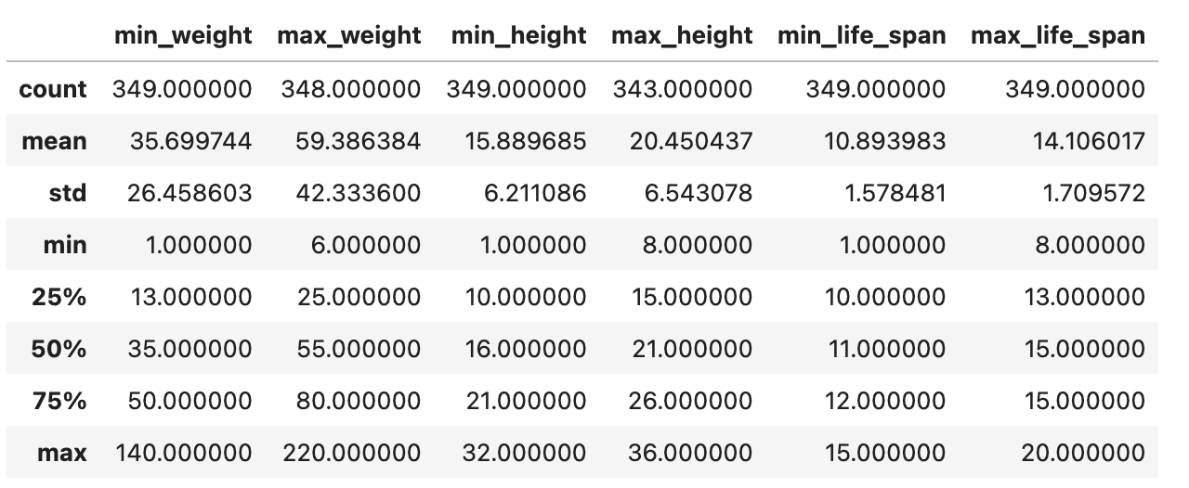
Data Cleaning & Exploratory Data Analysis

Slide 9
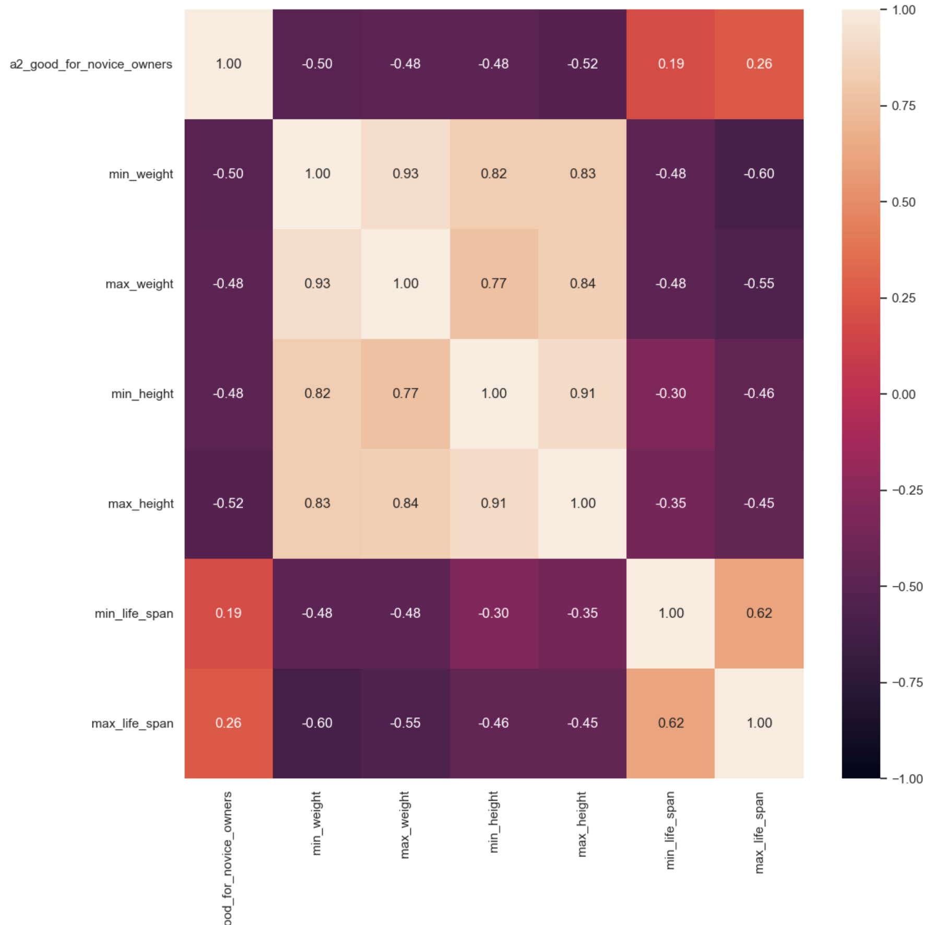
Data Cleaning & Exploratory Data Analysis
heatmap

Slide 10
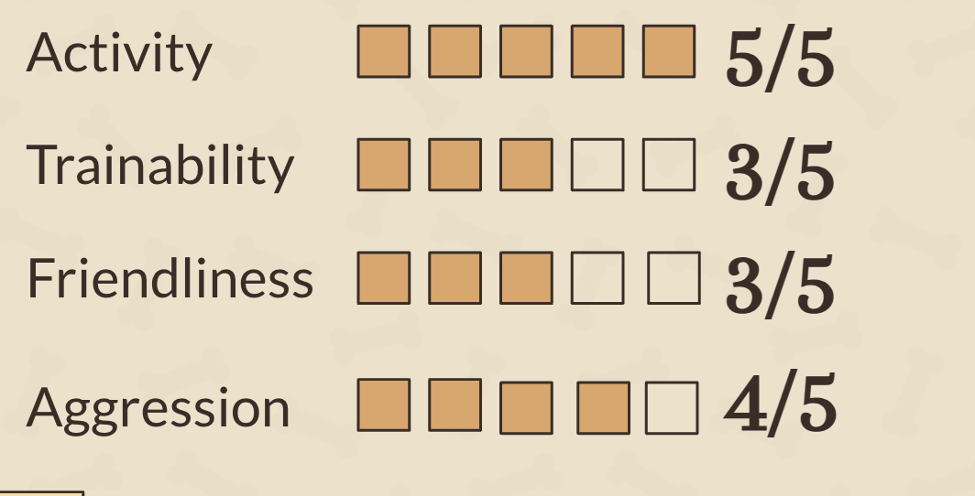
Data Cleaning & Exploratory Data Analysis
Top nine variables
Adapts_well_to_apartment_living
Size
Exercise_needs
Intensity
Drooling_potential
Dog_friendly
Friendly_toward_strangers
Easy_to_train
Tolerates_cold_weather

Slide 11
Machine Learning - Classification
Predictor features:
Adapts_well_to_apartment_living
Size
Exercise_needs
Intensity
Drooling_potential
Dog_friendly
Riendly_toward_strangers
Easy_to_train
Tolerates_cold_weather
Response variable:
Good for novice owners

Slide 12
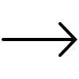
Models
Multi Layer Perceptron (MLP)
Random forest
Decision tree
Gaussian Naive Bayes
We will be comparing the accuracies of the results between the different models

Slide 13
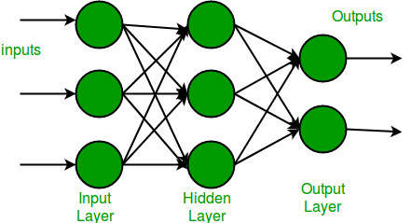
Multi Layer Perceptron (MLP)
Input layer receives the features with each node in the layer representing one feature.
In each node, there are hidden layers.
Inputs go through an activation function in each node.
Output layer will produce the classifications.

Slide 14
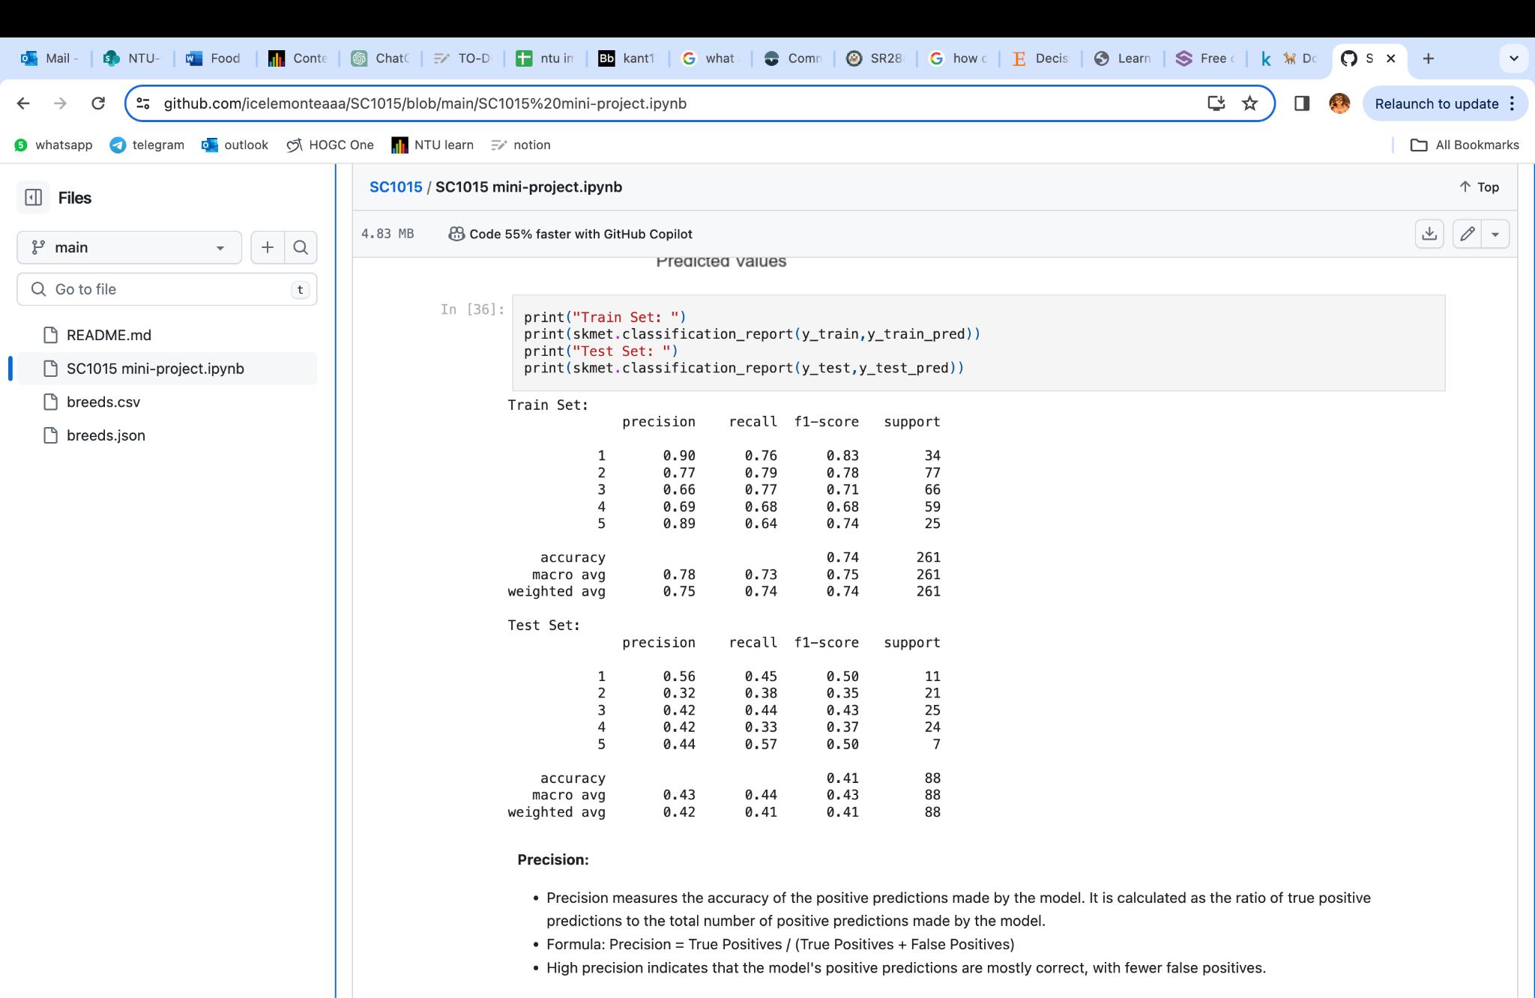
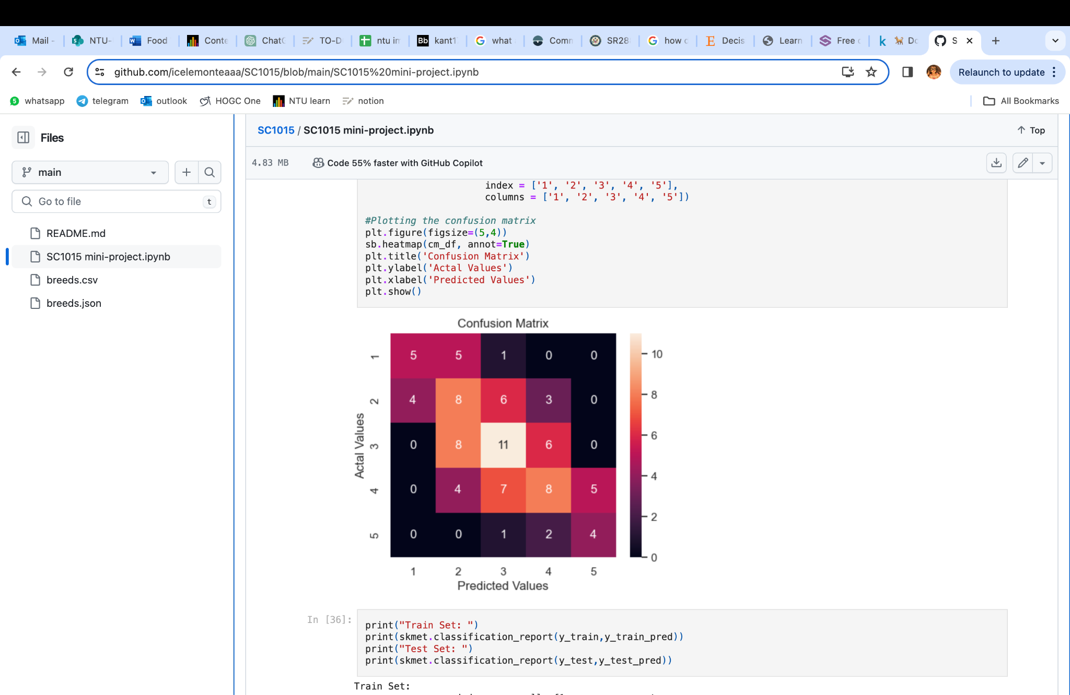
Multi Layer Perceptron
Accuracy on training set: 74.33%
Accuracy on test set: 40.91%

Slide 15
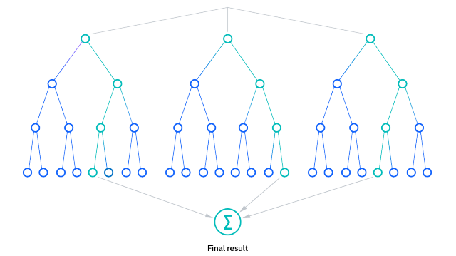
Random Forest
Randomly selects a subset of training data (with replacement) to build each decision tree.
Introduces randomness in feature selection.
Constructs multiple decision trees that grows recursively.
Combines the predictions of all the decision trees to make the final classification.

Slide 16
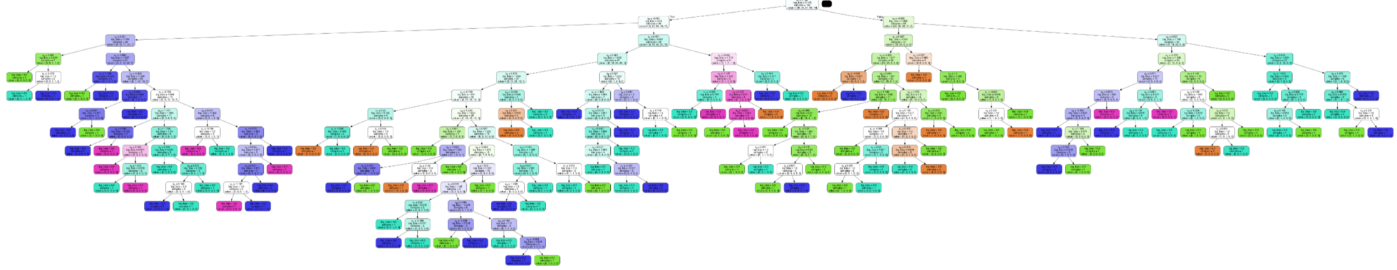
Random Forest
Accuracy on training set: 100%
Accuracy on test set: 43.18%

Slide 17
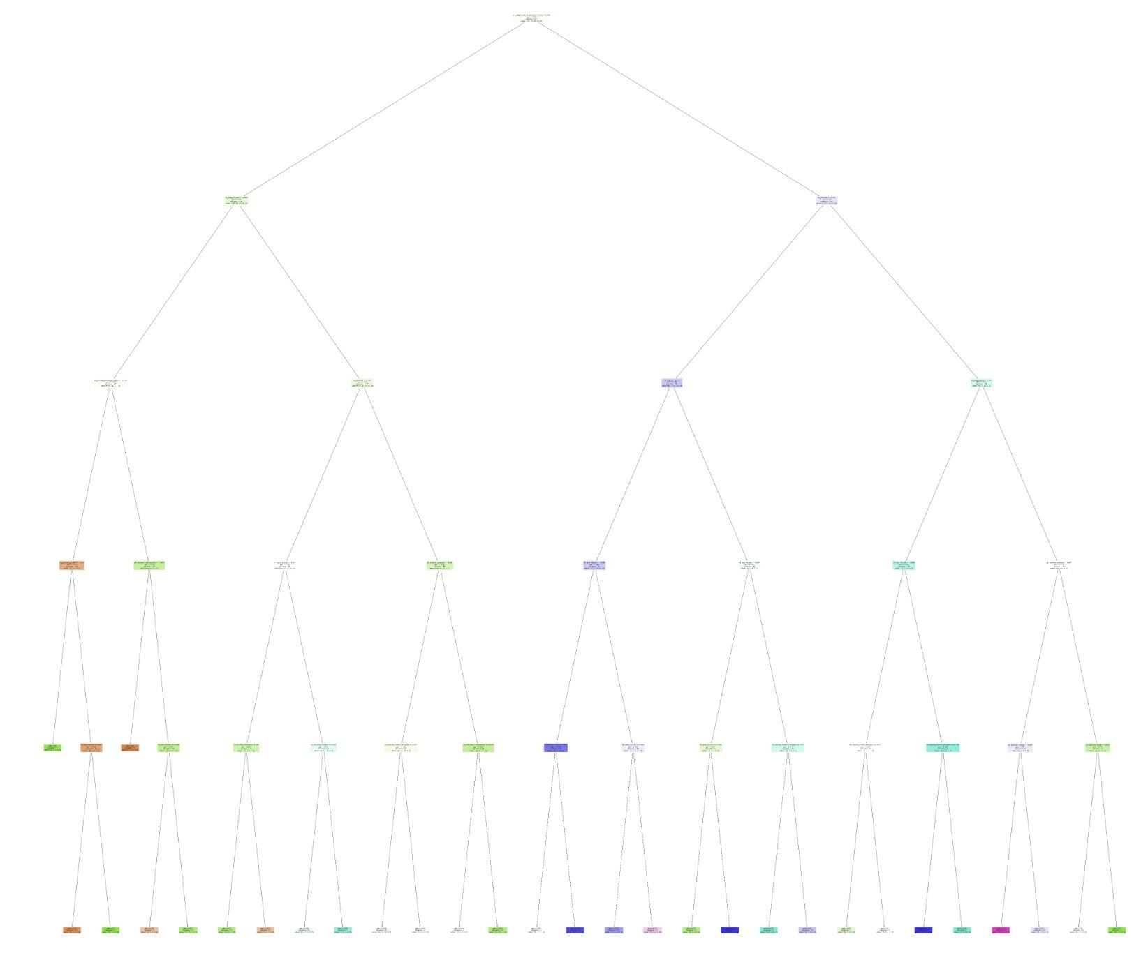
Decision Tree
Max Depth: 5
Classification Accuracy:
Train: 57.8%
Test: 43.2%
Max Depth: 4
Classification Accuracy:
Train: 51.3%
Test: 40.9%
Max Depth: 6
Classification Accuracy:
Train: 68.2%
Test: 37.5%

Slide 18
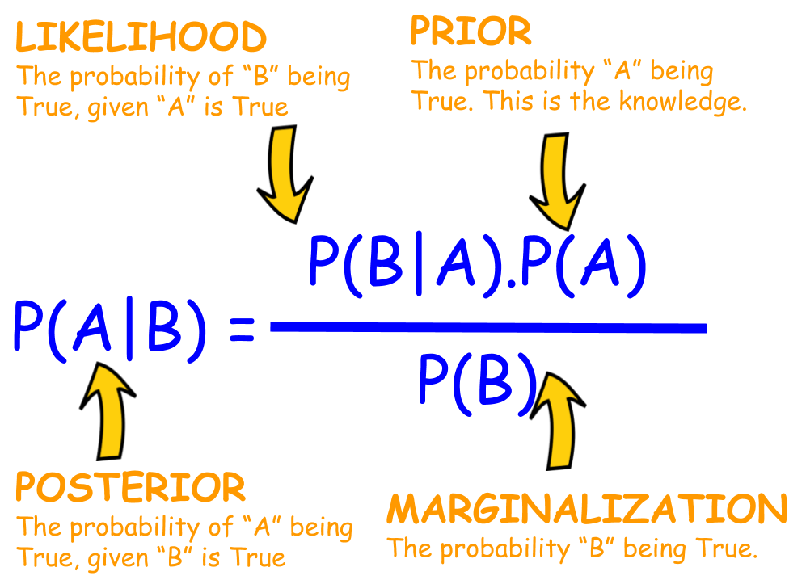
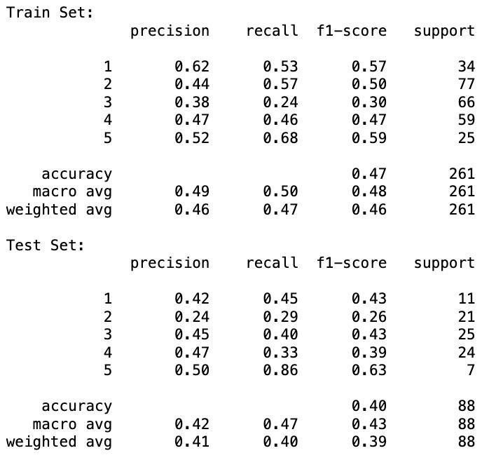
Gaussian Naive Bayes

Slide 19
Our Findings
Finding 1
Finding 2
Finding 3
All the models have relatively low accuracy
MLP and GNB has lower accuracy
Decision Tree and Random Forest has higher accuracy
Reason
Reason
Reason
“Good for novice owners” have 5 categories
MLP is complex
GNB assumes features are independent of each other
Models were less complex and thus is more appropriate

Slide 20
THANK YOU!

